Slide 1



Machine Learning with

Slide 2
Logistic Regression

Slide 3

Introduction to Logistic Regression
Logistic regression is a classification algorithm, used when the value of the target variable is categorical in nature.
Logistic regression is most commonly used when the data in question has binary output, so when it belongs to one class or another, or is either a 0 or 1.
Logistic Regression is a Machine Learning algorithm which is used for the classification problems, it is a predictive analysis algorithm and based on the concept of probability.

Slide 4
Logistic Regression
The idea of Logistic Regression is to find a relationship between features and probability of particular outcome .
E.g. When we have to predict if a student passes or fails in an exam when the number of hours spent studying is given as a feature, the response variable has two values, pass and fail.

Slide 5
Logistic Regression
Logistic Regression is one of the basic and popular algorithm to solve a classification problem. It is named as 'Logistic Regression', because it's underlying technique is quite the same as Linear Regression. The term “Logistic” is taken from the Logit function that is used in this method of classification.

Slide 6
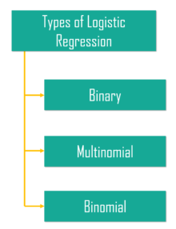
Types of Logistic Regression

Slide 7
Types of Logistic Regression
Binary logistic regression – It has only two possible outcomes. Example- yes or no
Multinomial logistic regression – It has three or more nominal categories . Example- cat, dog, elephant.
Ordinal logistic regression- It has three or more ordinal categories, ordinal meaning that the categories will be in a order. Example- user ratings(1-5).

Slide 8
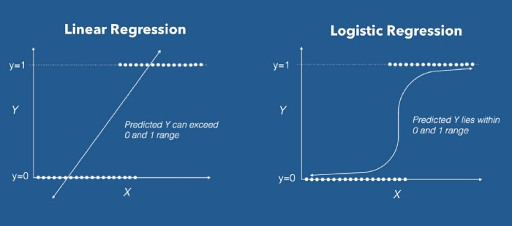

Slide 9
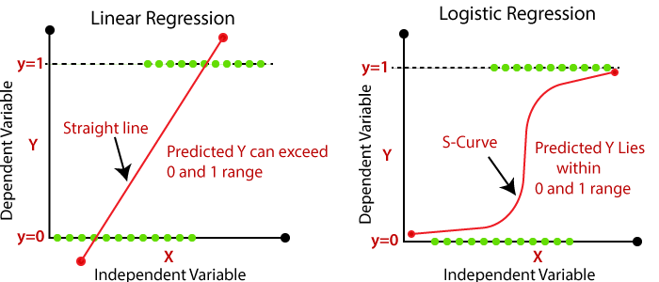

Slide 10
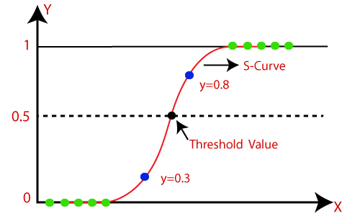

Slide 11
While linear regression can have infinite possible values, logistic regression has definite outcomes.
Linear regression is used when the response variable is continuous in nature, but logistic regression is used when the response variable is categorical in nature.
Example : Weather Prediction
Determining Illness

Slide 12
Thank you

